Slide 1

WELCOME TO
SPRINT ASSESSMENT on
DO NOT DISTURB(DND)
By Group B
Presented by
SHIKHA BHASKAR (TL)
MITALI SARAF
SIMRAN ANAND
AYUSHI SINGH
NISHU KUMARI
SONI KUMARI
Guided by
SANDEEP YADAV
(Trainer)

Slide 2
CONTENTS
INTRODUCTION
FEATURES
TOOLS
FLOW CHART
FUNCTIONALITY
ADVANTAGES & DISADVANTAGES
CONCLUSION
1111VCDSCDSCDNBJBJBJBJKBKJCKJDBCJD

Slide 3


INTRODUCTION
What is DND?
DND stands for Do Not Disturb.
DND is an initiative by TRAI (Telecom Regulatory Authority of India) to save telecom consumers from unsolicited calls/SMS. If a user registers his/her mobile number, then it would be illegal for telemarketers to send any sort of unsolicited SMS or calls on those numbers.

Slide 4
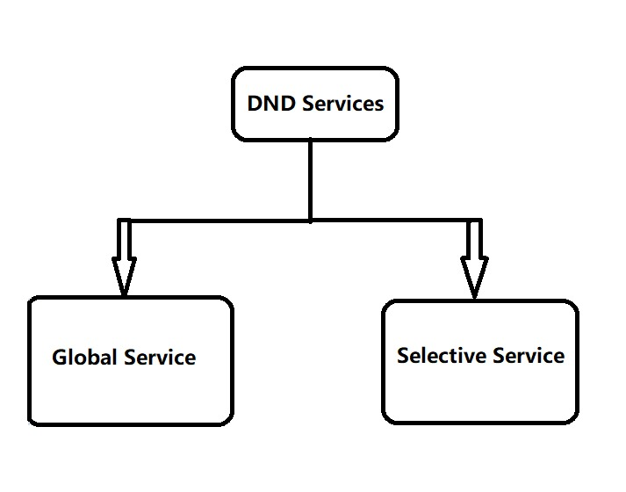
DND : FUNCTIONALITY
Register users can access both the services:-
Global service : All Calls are blocked
Selective service : Only selected calls are blocked

Slide 5
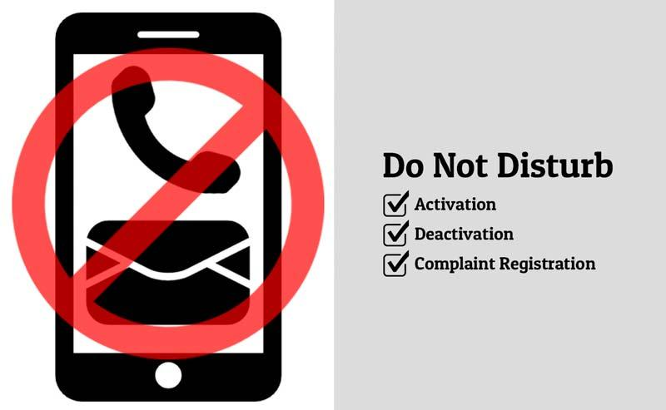
FUNCTIONALITY

Slide 6
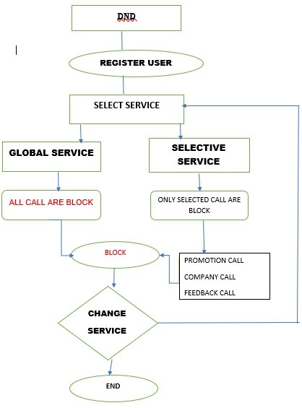
FLOWCHART

Slide 7
TOOLS
Ubuntu and Gcc Compiler
VI EDITOR
C Compiler

Slide 8
ADVANTAGE OF DND
The major advantage of this service is that you are at liberty to block unsolicited bulk calls from getting to your phone that are not useful to you.
DISADVANTAGE OF DND
If the subscriber already has a DND service active and subscriber again tries to activate this service (may be with a different option),he would not be allowed to do so until subscriber deactivates the service first.

Slide 9
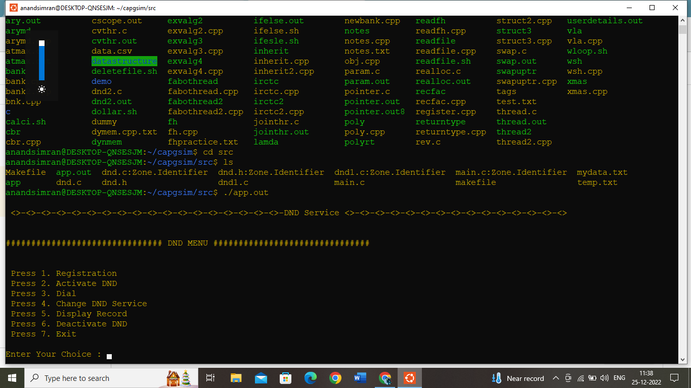
Here’s how our code works-

Slide 10
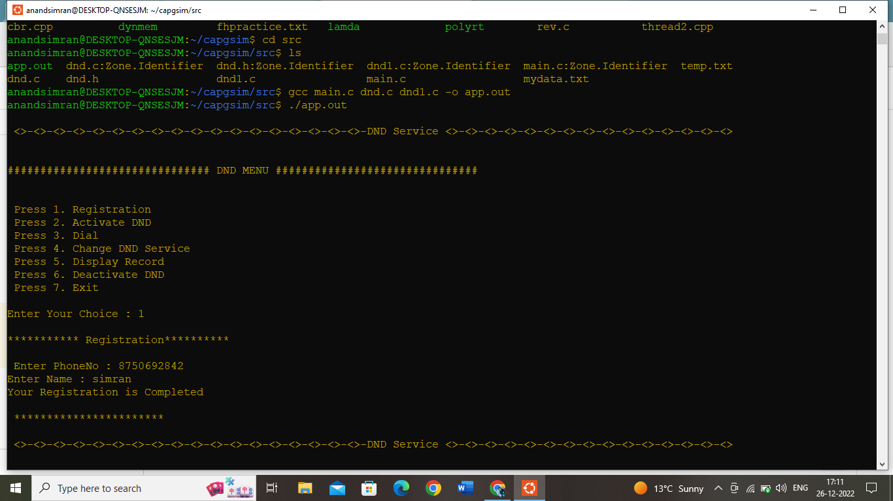

Slide 11
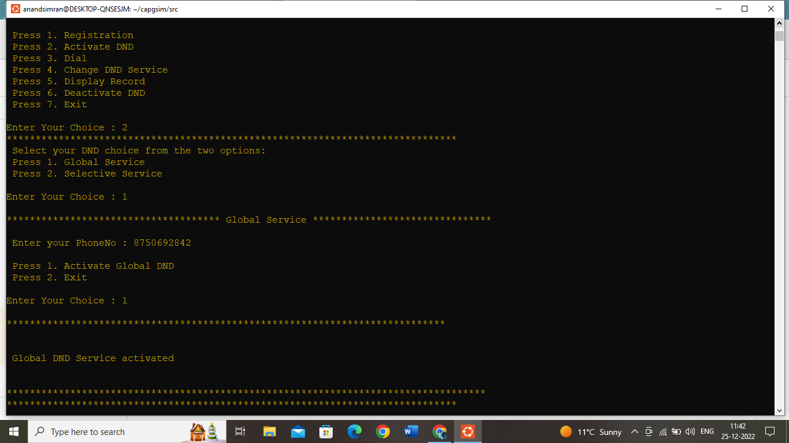

Slide 12
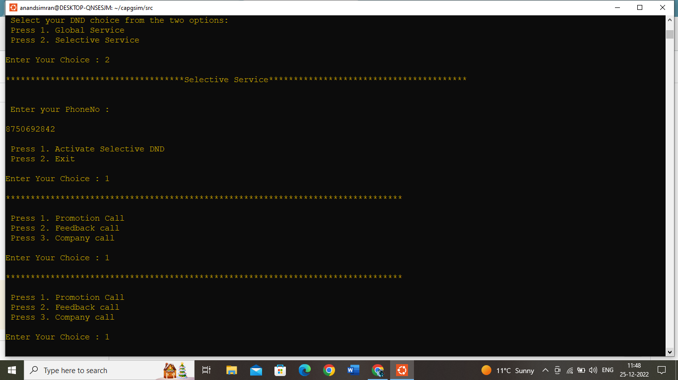

Slide 13
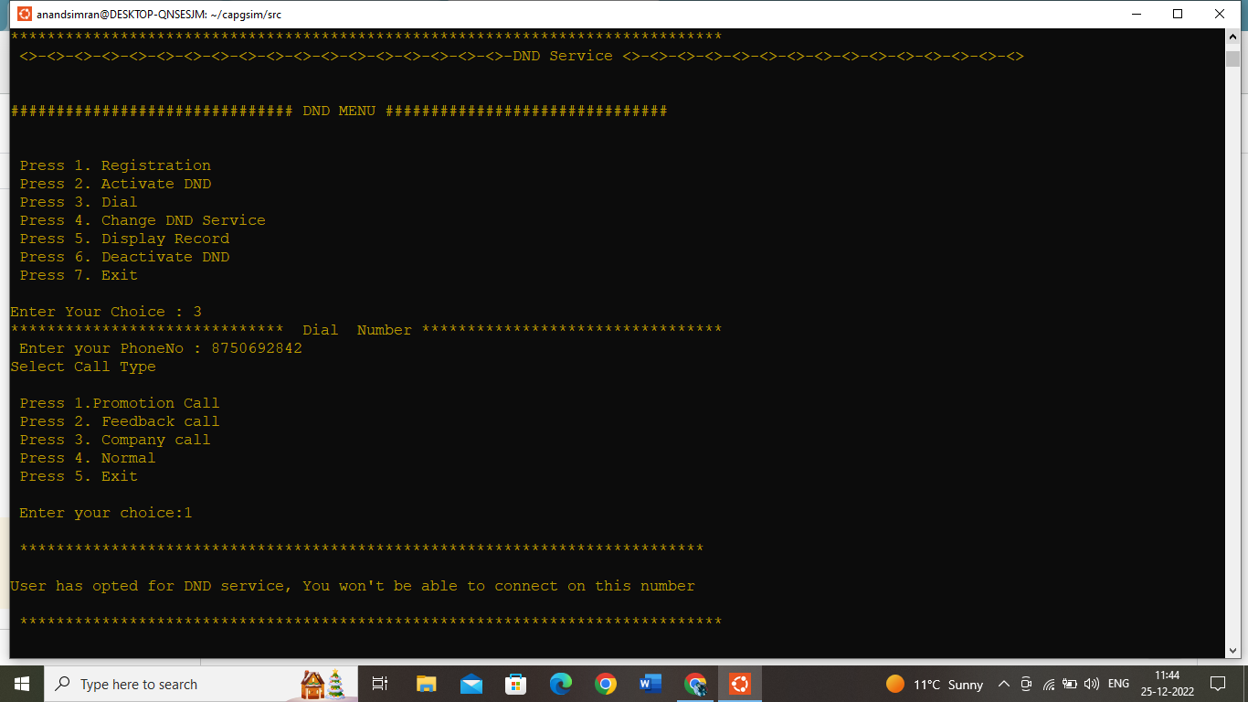

Slide 14
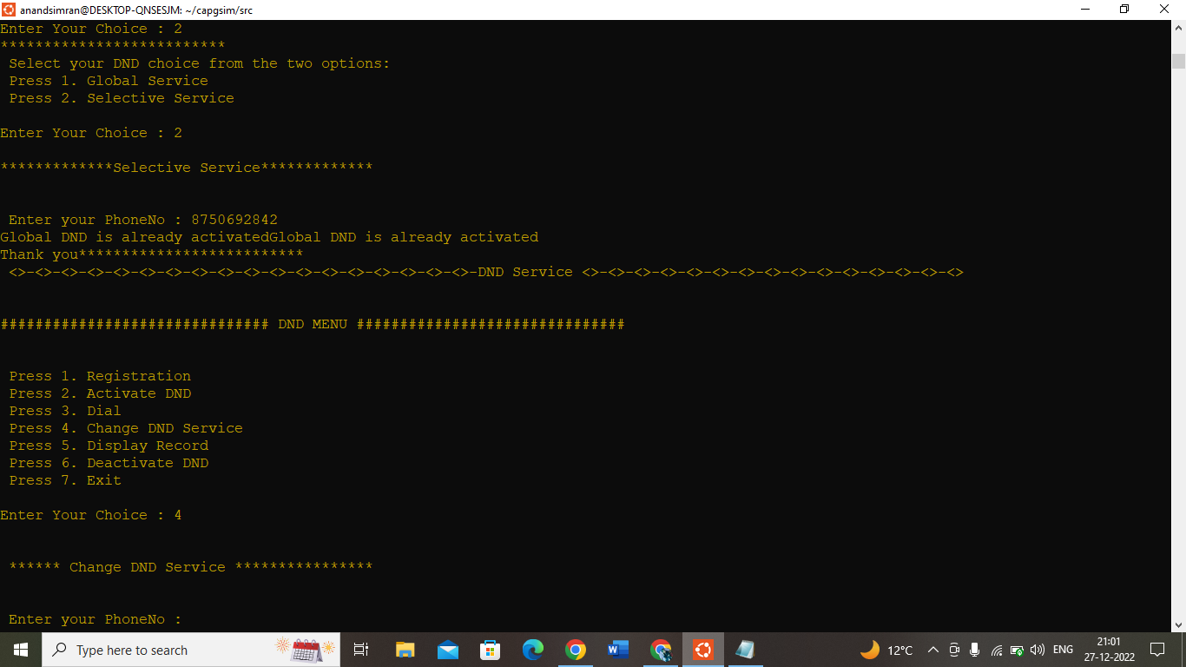

Slide 15
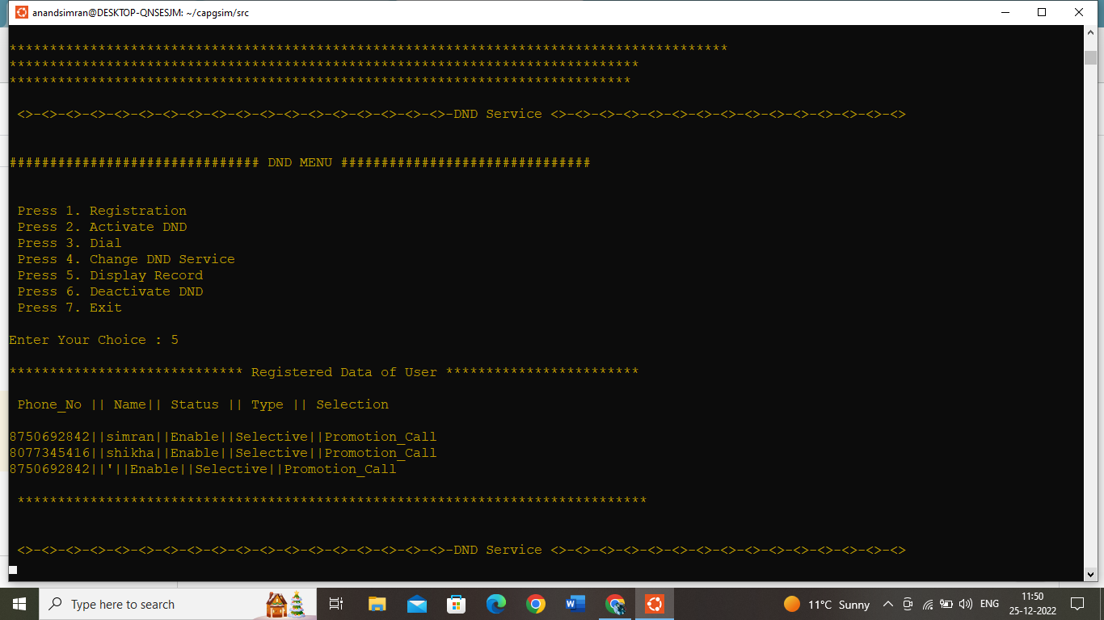

Slide 16
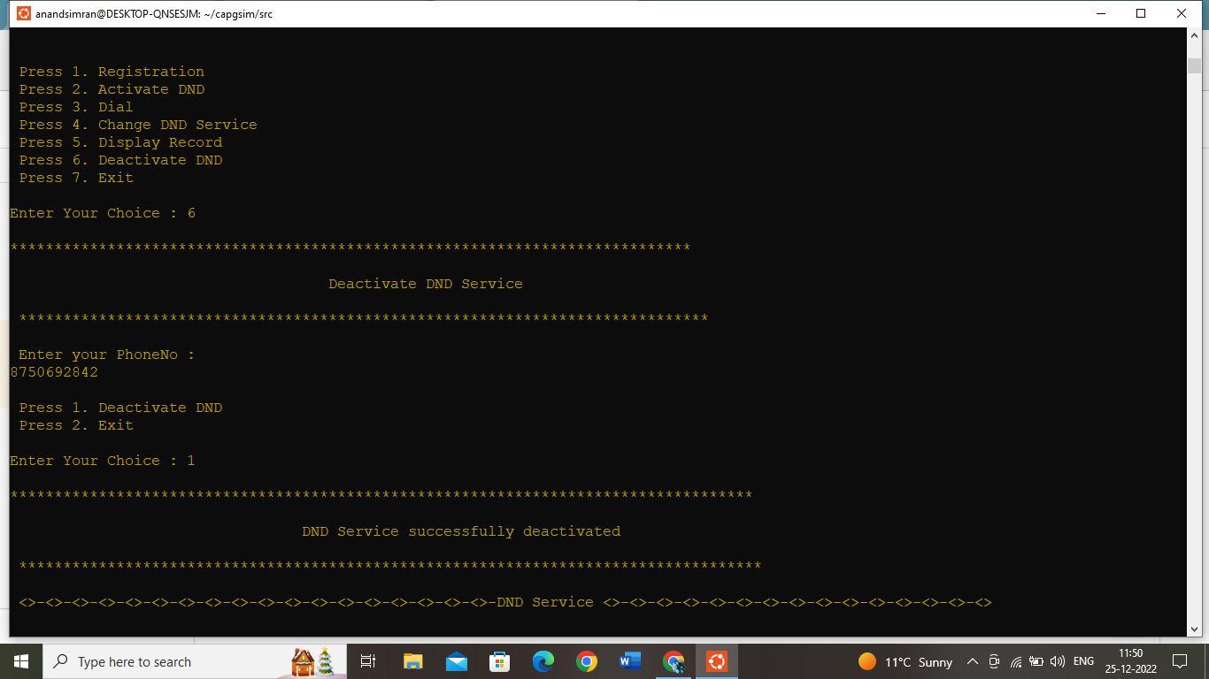

Slide 17
CONCLUSION
Do Not Disturb(DND) is a feature through which users can mute unwanted calls. DND gives facility to customize calls by selecting Do Not Disturb option.
The DND allows you to put your calls in totally silence or control the DND which time you want to receive calls within a period.
You can set up a DND rule that blocks all your phone calls from both unsaved contacts and contact but allow calls from a specific group of contact.
DND is one of the best features to focus on our essential activities.

Slide 18

v
v
v

